Slide 1
REVIEW
FOR Midterm!

Slide 2

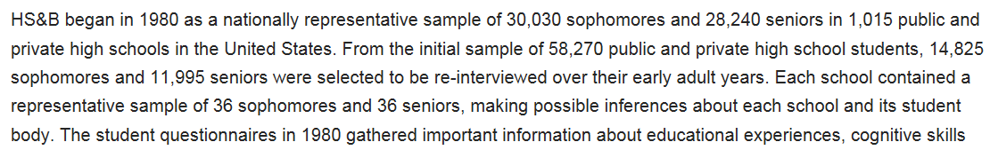

Slide 3
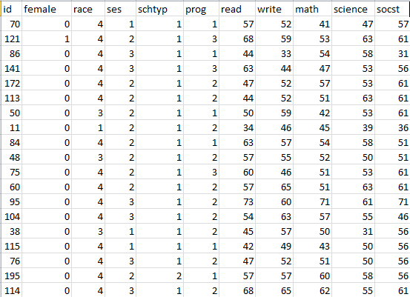
HSB2 Data Set:
This data file contains 200 observations from a sample of high school students with demographic information about the students, such as their gender (female), socio-economic status (ses) and ethnic background (race). It also contains a number of scores on standardized tests, including tests of reading (read), writing (write), mathematics (math) and social studies (socst).

Slide 4
Review!!!!
Download the HSB2 Dataset and import into a SAS session.
Test the claim that the mean writing score is equal to 50. Write all steps.
Test the claim that the mean writing score is different for males and females. Include all steps.
There are 4 unique race categories. Test to see if the 1st race has a different mean writing score than the 4th race.

Slide 5
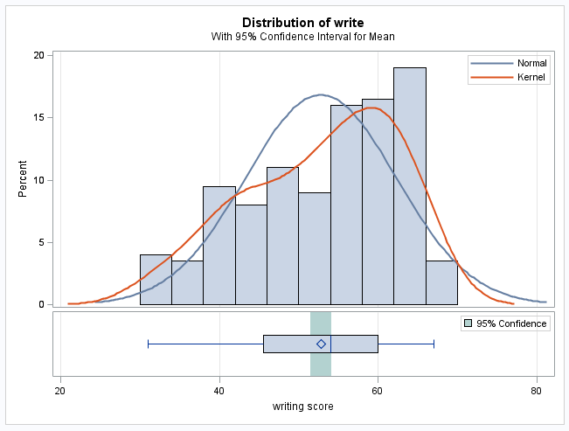
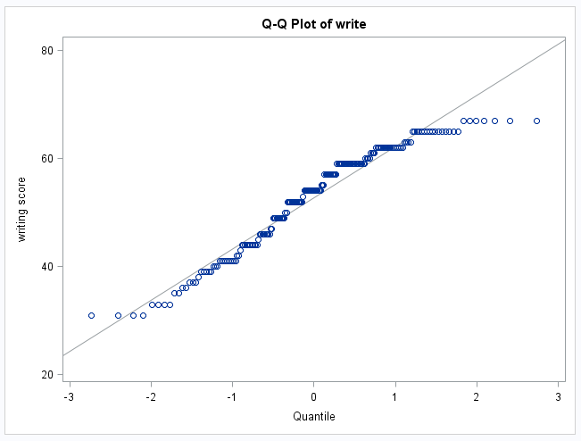
2. Test the claim that the mean writing score is equal to 50. Write all steps.
Problem Statement: Test the claim that the mean writing score is significantly different from 50.
Assumptions:
The histogram and q-q plot provide strong evidence of a left skew, although the sample size of 200 should ensure that the sample mean will be normally distributed (central limit theorem). We will assume the scores are independent of one another and proceed with a one-sample t-test.
*A transformation is another option if it improves normality, but the inference will be on the median (for log transform).

Slide 6

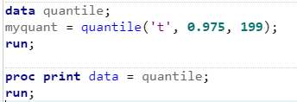



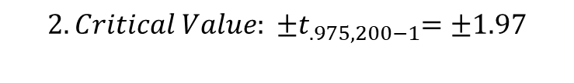
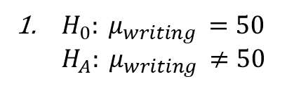



2. Test the claim that the mean writing score is equal to 50. Write all 6 steps of the hypothesis test.
${ H}_{0}: μ_{writing }=50$
$${ H}_{A}: μ_{writing }≠50$$
$$2. Critical Value: {±t}_{.975, 200−1}=±1.97$$
6. There is strong evidence to suggest at the alpha = .05 level of significance (p-value < .0001) that the mean writing score is different than 50 points. A 95% confidence interval for the true mean writing score is
(51.5 points, 54.1 points). We can infer that the mean is not equal to 50 for the entire population of interest as the data was a random sample.
Can you finish the test from here? Try it and then step through the answers!
$$3. Test Statistic:4.14$$
$$4. P−value< .0001$$
$$5.Reject H_{0}$$

Slide 7
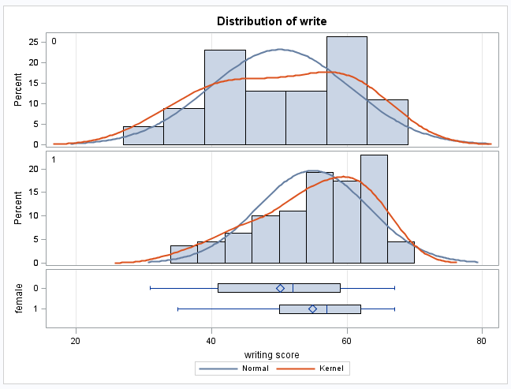
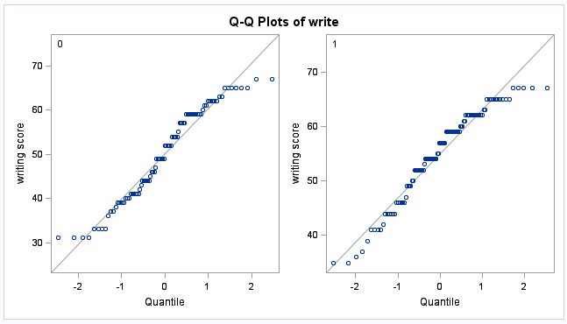
3. Test the claim that the mean writing score is different for males and females. Include all steps.
Problem statement: Test the claim that the mean writing score is different for males and females.
Assumptions:
While there is not significant evidence that the male writing scores (female = 0) are not normally distributed, the histograms and q-q plots provide evidence of a slight left skewed distribution of writing scores for females (female = 1). However, since there are 91 in the male group and 109 in the female group, the Central Limit Theorem will ensure that sample means from these distributions are normally distributed, thus making the t-test robust to the normality assumption.
We will assume the scores are independent of one another both within and between groups.

Slide 8

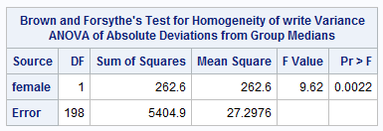

3. Test the claim that the mean writing score is different for males and females. Include all steps.
The histograms on the last slide were somewhat inconclusive on the question of equality of variances. For this reason, we seek secondary evidence in the form of a formal hypothesis test. Since there is some evidence that the writing scores are not normally distributed, the Brown-Forsythe test of equality of variance should be used instead of the F-Test. There is significant evidence at the alpha = .05 level of significance (p-value = .0022) to suggest that the variance of the male writing scores is different from that of the females.
There is some evidence that the standard deviations are different; therefore, since the Welch’s t-test is nearly as powerful as the Student t-test even when the standard deviations are the same, we will proceed with the Welch’s test of the difference of means.
*A transformation is another option if it improves normality and makes variances more equal.

Slide 9
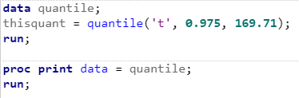


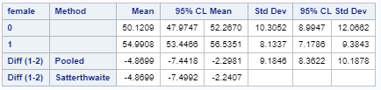




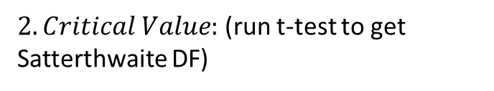
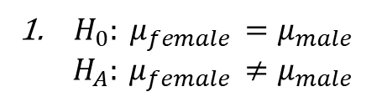
3. Test the claim that the mean writing score is different for males and females. Include all 6 steps of the hypothesis test.
${ H}_{0}: μ_{female }=μ_{male }$
$${ H}_{A}: μ_{female }≠μ_{male }$$
6. There is strong evidence to suggest at the alpha = .05 level of significance (p-value = .0003) that the mean writing score of female high school students in the U.S. is different than the mean writing score of males. (Note the inference to the broader population.) This was an observational study; thus, no causal inference can be deduced. A 95% confidence interval for this difference is: (2.2 points, 7.5 points)-the positive difference in favor of females.
$2. Critical Value:$ (run t-test to get Satterthwaite DF)
Can you finish the test from here? Try it and then step through the answers!
±$t_{.975,169.71}=\text{±}1.97$
$$3. Test Statistic:−3.66$$
$$4. P−value= .0003$$
$$5.Reject H_{0}$$

Slide 10
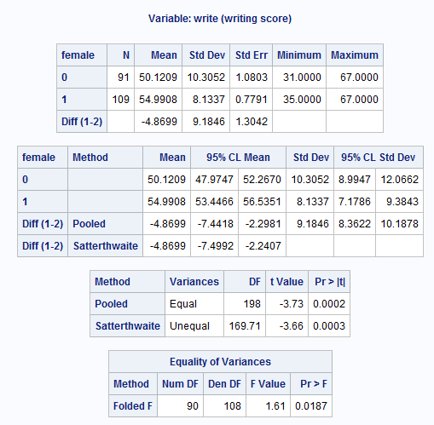

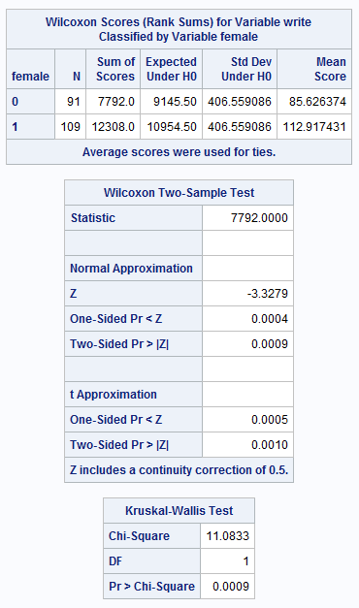
3. Test the claim that the mean writing score is different for males and females. Welch’s t-test vs. alternative solution: Nonparametric options

Slide 11
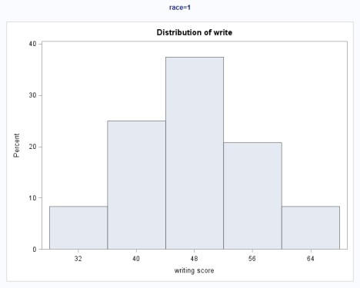
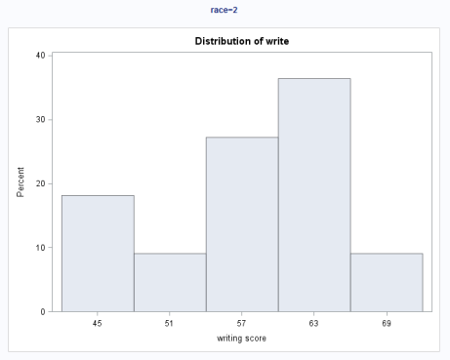
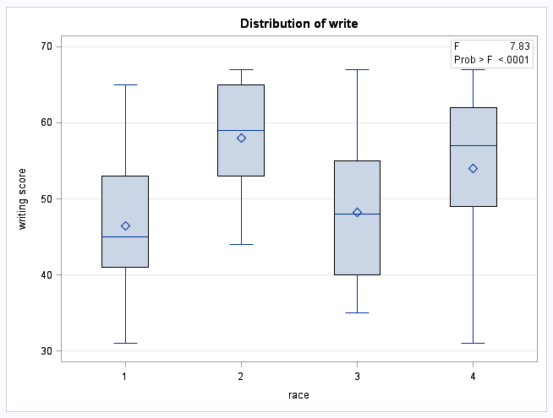
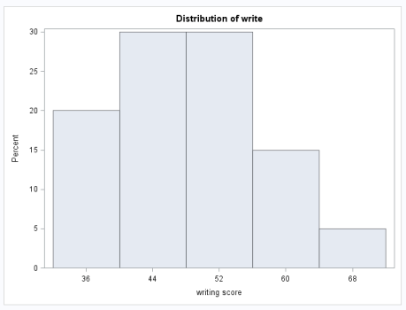
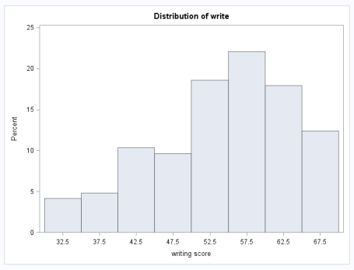
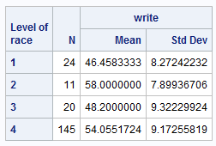
4. There are 4 unique race categories. Test to see if the 1st race has a different mean writing score than the 4th race.
Problem Statement: Test the claim that the writing scores of the first and fourth race significantly different. First, we will test the claim that any of the means/medians are different.
Assumptions:
While the only histogram that provides strong evidence (n = 145 and a considerable left skew) against normality is race = 4, that is the group with the largest sample size. Remember that with small sample sizes, it is difficult to ascertain the true shape of the underlying distribution. There is no reason to believe the shape of the other races should be any different than the shape of the distribution of writing scores of race = 4. We will assume that the shapes (although maybe not the locations) of the distributions of the underlying populations of the first three groups are the same as that of the last (skewed) group. Some smaller sample sizes make it unclear that the CLT will kick in, calling the normality of some of the sample means into question. For this reason, we will conduct a Kruskal-Wallis Test and make our inference about the medians.
*A transformation is another option if it improves normality and makes variances more equal.

Slide 12
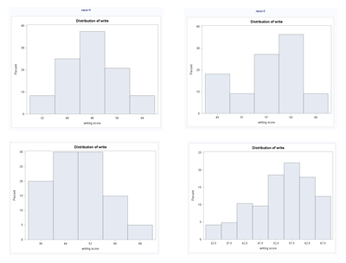

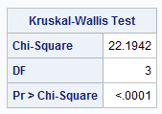



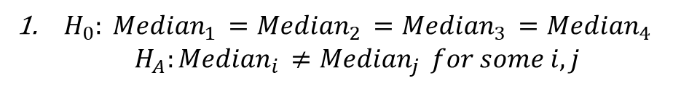

4. There are 4 unique race categories. Test to see if the 1st race has a different mean writing score than the 4th race.
Again, given that the other groups have small sample sizes and there is no reason to believe the shape of the other races should be any different than the shape of the distribution of writing scores of race = 4, we will assume that the shapes (although maybe not the locations) of the distributions are the same. For this reason we will conduct a Kruskal-Wallis Test and make our inference about the medians.
${ H}_{0}: {Median}_{1 }={Median}_{2 }={Median}_{3 }={Median}_{4 }$
$${ H}_{A}:{Median}_{i }≠{Median}_{j } for some i,j$$
$$2. Critical Value:can skip$$
Can you finish the test from here? Try it and then step through the answers!
$$3. Test Statistic:χ^{2}=22.1942$$
$$4. P−value< .0001$$
$$5.Reject H_{0}$$
There is sufficient evidence at the alpha = .05 level of significance (p-value < .0001) that at least one of the medians is different among the race groups.
Next, we shall test to see if the 1st race has a different median than the 4th race. A multiple comparison adjustment is not needed here since our hypothesis was formulated before we looked at the data and we are only examining one comparison.

Slide 13
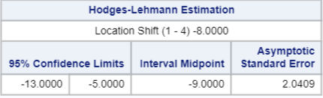
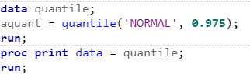
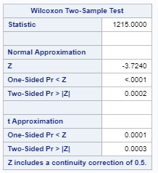


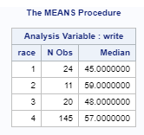

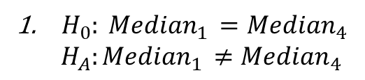



4. There are 4 unique race categories. Test to see if the 1st race has a different mean writing score than the 4th race.
A Wilcoxon Rank Sum test will be performed between the two groups.
${ H}_{0}: {Median}_{1 }={Median}_{4 }$
$${ H}_{A}:{Median}_{1 }≠{Median}_{4 }$$
$$2. Critical Value:z_{.975}≅±1.96$$
$$3. Test Statistic:z=−3.72$$
$$4. P−value= .0002$$
$$5.Reject H_{0}$$
6. There is strong evidence to suggest at the alpha = .05 level of significance (p-value = .0002 from the Rank Sum Test) that the median writing score of U.S. high school students with race = 1 is different than the median writing score of those of race = 4. This was an observational study; thus, no causal inference can be deduced. The best estimate of the difference in locations is 8, in favor of race 4 scores, with a Hodges-Lehmann 95% confidence interval of the difference of (5 points, 13 points).
*Note that the difference in medians is actually 12. That is because the HL confidence interval is not exactly for the medians when the data is not symmetric.
Can you finish the test from here? Try it and then step through the answers!

Slide 14




4. There are 4 unique race categories. Test to see if the 1st race has a different mean writing score than the 4th race. ALTERNATIVE SOLUTION: CONTRASTS
The race = 4 histogram provides strong evidence (n = 145 and a considerable left skew) against normality. While the other histograms do not provide much evidence against normality, they are based on small sample sizes and may indeed be left skewed as the evidence suggests race = 4 is. However, it can be argued that even the smallest group n = 11 has a sufficient sample size to ensure the central limit theorem will provide normally distributed sample means. For this reason, we will proceed with an ANOVA and t-tests for the planned analysis. In addition, we will assume the standard deviations are equal although this is a risky assumption given the data has very unequal sample sizes.

Slide 15

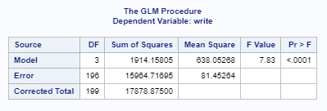
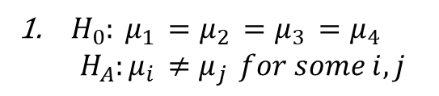




4. There are 4 unique race categories. Test to see if the 1st race has a different mean writing score than the 4th race. ALTERNATIVE SOLUTION: CONTRASTS (first ANOVA)
${ H}_{0}: μ_{1 }=μ_{2 }=μ_{3 }=μ_{4 }$
$${ H}_{A}:μ_{i }≠μ_{j } for some i,j$$
$$2. Critical Value:can skip$$
$$3. Test Statistic:F=7.83$$
$$4. P−value< .0001$$
$$5.Reject H_{0}$$
6. There is sufficient evidence at the alpha = .05 level of significance (p-value < .0001) that at least one of the means is different between the race groups.
Next, we shall test to see if the 1st race has a different mean than the 4th race. A multiple comparison adjustment is not needed here since our hypothesis was formulated before we looked at the data.

Slide 16
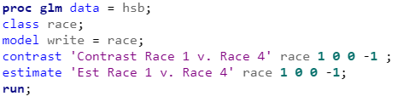



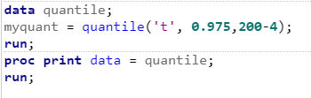
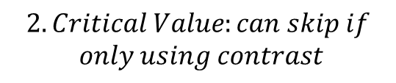
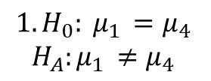

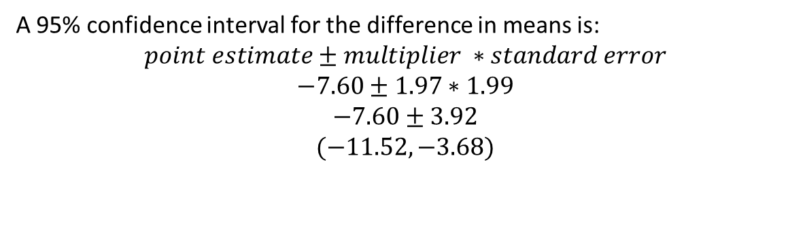
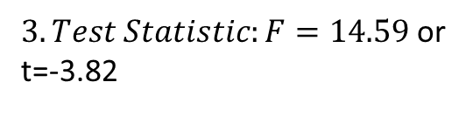
4. There are 4 unique race categories. Test to see if the 1st race has a different mean writing score than the 4th race. ALTERNATIVE SOLUTION: CONTRASTS
$$1.H_{0}: μ_{1 }=μ_{4 }$$
$$H_{A}:μ_{1 }≠μ_{4 }$$
$$2. Critical Value:can skip if$$
$$only using contrast$$
$3. Test Statistic:F=14.59$ or
t=-3.82
$$4. P−value= .0002$$
$$5.Reject H_{0}$$
6. There is strong evidence at the alpha = .05 level of significance (p-value = .0002 from a two sample t-test) to suggest that the mean writing score of race = 1 U.S. high school students is different than that of students who are race = 4. This was an observational study. Therefore, no causation can be inferred.
Can you finish the test from here? Try it and then step through the answers! Provide a confidence intrerval as well!
A 95% confidence interval for the difference in means is:
$$point estimate±multiplier ∗standard error$$
$$−7.60±1.97∗1.99$$
$$−7.60±3.92$$
$$(−11.52, −3.68)$$

Slide 17
Compare the contrast (race 1 vs. 4) to building your own F-table (using plain ANOVAs).
STOP HERE FOR BREAK OUT 1… START HERE FOR BREAKOUT 2.
Reduced Model:
Full model:
Source | DF | SS | MS | F | Pr > F
Model
Error
Total

Slide 18


Compare the contrast (race 1 vs. 4) to building your own F-table (using plain ANOVAs).
Reduced model:
Reduced model:
Full model:
Full Model:
Reduced Model: $μ_{o}$ $μ_{2}$ $μ_{3}$ $μ_{o}$
Full model: $μ_{1}$ $μ_{2}$ $μ_{3}$ $μ_{4}$
Source | DF | SS | MS | F | Pr > F
Model
Error
Total

Slide 19


Compare the contrast (race 1 vs. 4) to building your own F-table (using plain ANOVAs).
Reduced model: $μ$ $μ$ $μ$ $μ$
Reduced model: $μ$ $μ$ $μ$ $μ$
Full model:
Full Model:
Reduced Model: $μ_{o}$ $μ_{2}$ $μ_{3}$ $μ_{o}$
Full model: $μ_{1}$ $μ_{2}$ $μ_{3}$ $μ_{4}$
Source | DF | SS | MS | F | Pr > F
Model
Error
Total

Slide 20

Compare the contrast (race 1 vs. 4) to building your own F-table (using plain ANOVAs).
Reduced model: $μ$ $μ$ $μ$ $μ$
Reduced model: $μ$ $μ$ $μ$ $μ$
Full model: $μ_{1}$ $μ_{2}$ $μ_{3}$ $μ_{4}$
Full Model:
Reduced Model: $μ_{o}$ $μ_{2}$ $μ_{3}$ $μ_{o}$
Full model: $μ_{1}$ $μ_{2}$ $μ_{3}$ $μ_{4}$
Source | DF | SS | MS | F | Pr > F
Model
Error
Total

Slide 21

Compare the contrast (race 1 vs. 4) to building your own F-table (using plain ANOVAs).
Reduced model: $μ$ $μ$ $μ$ $μ$
Reduced model: $μ$ $μ$ $μ$ $μ$
Full model: $μ_{1}$ $μ_{2}$ $μ_{3}$ $μ_{4}$
Full Model: $μ_{o}$ $μ_{2}$ $μ_{3}$ $μ_{o}$ *recode
Reduced Model: $μ_{o}$ $μ_{2}$ $μ_{3}$ $μ_{o}$
Full model: $μ_{1}$ $μ_{2}$ $μ_{3}$ $μ_{4}$
Source | DF | SS | MS | F | Pr > F
Model
Error
Total

Slide 22
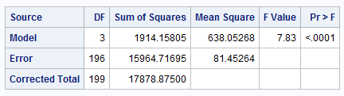
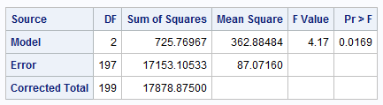
Compare the contrast (race 1 vs. 4) to building your own F-table (using plain ANOVAs).
Reduced model: $μ$ $μ$ $μ$ $μ$
Reduced model: $μ$ $μ$ $μ$ $μ$
Full model: $μ_{1}$ $μ_{2}$ $μ_{3}$ $μ_{4}$
Full Model: $μ_{o}$ $μ_{2}$ $μ_{3}$ $μ_{o}$ *recode
Reduced Model: $μ_{o}$ $μ_{2}$ $μ_{3}$ $μ_{o}$
Full model: $μ_{1}$ $μ_{2}$ $μ_{3}$ $μ_{4}$
Source | DF | SS | MS | F | Pr > F
Model
Error
Total
Can you finish the table from here? Try it and then step through the answers!

Slide 23
Compare the contrast (race 1 vs. 4) to building your own F-table (using plain ANOVAs).
Reduced model: $μ$ $μ$ $μ$ $μ$
Reduced model: $μ$ $μ$ $μ$ $μ$
Full model: $μ_{1}$ $μ_{2}$ $μ_{3}$ $μ_{4}$
Full Model: $μ_{o}$ $μ_{2}$ $μ_{3}$ $μ_{o}$ *recode
Reduced Model: $μ_{o}$ $μ_{2}$ $μ_{3}$ $μ_{o}$
Full model: $μ_{1}$ $μ_{2}$ $μ_{3}$ $μ_{4}$
Source | DF | SS | MS | F | Pr > F
Model
Error | 196 | 15964.71695
Total

Slide 24
Compare the contrast (race 1 vs. 4) to building your own F-table (using plain ANOVAs).
Reduced model: $μ$ $μ$ $μ$ $μ$
Reduced model: $μ$ $μ$ $μ$ $μ$
Full model: $μ_{1}$ $μ_{2}$ $μ_{3}$ $μ_{4}$
Full Model: $μ_{o}$ $μ_{2}$ $μ_{3}$ $μ_{o}$ *recode
Reduced Model: $μ_{o}$ $μ_{2}$ $μ_{3}$ $μ_{o}$
Subtract to get the df (degrees of freedom) and SS (sum of squares) for top row.
Full model: $μ_{1}$ $μ_{2}$ $μ_{3}$ $μ_{4}$
Source | DF | SS | MS | F | Pr > F
Model
Error | 196 | 15964.71695
Total | 197 | 17153.10533

Slide 25
Compare the contrast (race 1 vs. 4) to building your own F-table (using plain ANOVAs).
Reduced model: $μ$ $μ$ $μ$ $μ$
Reduced model: $μ$ $μ$ $μ$ $μ$
Full model: $μ_{1}$ $μ_{2}$ $μ_{3}$ $μ_{4}$
Full Model: $μ_{o}$ $μ_{2}$ $μ_{3}$ $μ_{o}$ *recode
Reduced Model: $μ_{o}$ $μ_{2}$ $μ_{3}$ $μ_{o}$
Subtract to get the df (degrees of freedom) and SS (sum of squares) for top row.
Full model: $μ_{1}$ $μ_{2}$ $μ_{3}$ $μ_{4}$
Source | DF | SS | MS | F | Pr > F
Model | 1 | 1188.3883
Error | 196 | 15964.71695
Total | 197 | 17153.10533

Slide 26
Compare the contrast (race 1 vs. 4) to building your own F-table (using plain ANOVAs).
Reduced model: $μ$ $μ$ $μ$ $μ$
Reduced model: $μ$ $μ$ $μ$ $μ$
Full model: $μ_{1}$ $μ_{2}$ $μ_{3}$ $μ_{4}$
Full Model: $μ_{o}$ $μ_{2}$ $μ_{3}$ $μ_{o}$ *recode
Reduced Model: $μ_{o}$ $μ_{2}$ $μ_{3}$ $μ_{o}$
Divide to get the MS column (SS/df) for each row. You may omit the last row MS calculation.
Full model: $μ_{1}$ $μ_{2}$ $μ_{3}$ $μ_{4}$
Source | DF | SS | MS | F | Pr > F
Model | 1 | 1188.3883
Error | 196 | 15964.71695
Total | 197 | 17153.10533

Slide 27
Compare the contrast (race 1 vs. 4) to building your own F-table (using plain ANOVAs).
Reduced model: $μ$ $μ$ $μ$ $μ$
Reduced model: $μ$ $μ$ $μ$ $μ$
Full model: $μ_{1}$ $μ_{2}$ $μ_{3}$ $μ_{4}$
Full Model: $μ_{o}$ $μ_{2}$ $μ_{3}$ $μ_{o}$ *recode
Reduced Model: $μ_{o}$ $μ_{2}$ $μ_{3}$ $μ_{o}$
Divide to get the MS column (SS/df) for each row. You may omit the last row MS calculation.
Full model: $μ_{1}$ $μ_{2}$ $μ_{3}$ $μ_{4}$
Source | DF | SS | MS | F | Pr > F
Model | 1 | 1188.3883 | 1188.3883
Error | 196 | 15964.71695 | 81.45264
Total | 197 | 17153.10533

Slide 28
Compare the contrast (race 1 vs. 4) to building your own F-table (using plain ANOVAs).
Reduced model: $μ$ $μ$ $μ$ $μ$
Reduced model: $μ$ $μ$ $μ$ $μ$
Full model: $μ_{1}$ $μ_{2}$ $μ_{3}$ $μ_{4}$
Full Model: $μ_{o}$ $μ_{2}$ $μ_{3}$ $μ_{o}$ *recode
Reduced Model: $μ_{o}$ $μ_{2}$ $μ_{3}$ $μ_{o}$
Divide to get the F statistic (MS_{Model}/MS_{Error}).
Full model: $μ_{1}$ $μ_{2}$ $μ_{3}$ $μ_{4}$
Source | DF | SS | MS | F | Pr > F
Model | 1 | 1188.3883 | 1188.3883
Error | 196 | 15964.71695 | 81.45264
Total | 197 | 17153.10533

Slide 29
Compare the contrast (race 1 vs. 4) to building your own F-table (using plain ANOVAs).
Reduced model: $μ$ $μ$ $μ$ $μ$
Reduced model: $μ$ $μ$ $μ$ $μ$
Full model: $μ_{1}$ $μ_{2}$ $μ_{3}$ $μ_{4}$
Full Model: $μ_{o}$ $μ_{2}$ $μ_{3}$ $μ_{o}$ *recode
Reduced Model: $μ_{o}$ $μ_{2}$ $μ_{3}$ $μ_{o}$
Divide to get the F statistic (MS_{Model}/MS_{Error}).
Full model: $μ_{1}$ $μ_{2}$ $μ_{3}$ $μ_{4}$
Source | DF | SS | MS | F | Pr > F
Model | 1 | 1188.3883 | 1188.3883 | 14.59
Error | 196 | 15964.71695 | 81.45264
Total | 197 | 17153.10533

Slide 30


Compare the contrast (race 1 vs. 4) to building your own F-table (using plain ANOVAs).
Reduced model: $μ$ $μ$ $μ$ $μ$
Reduced model: $μ$ $μ$ $μ$ $μ$
Full model: $μ_{1}$ $μ_{2}$ $μ_{3}$ $μ_{4}$
Full Model: $μ_{o}$ $μ_{2}$ $μ_{3}$ $μ_{o}$ *recode
Reduced Model: $μ_{o}$ $μ_{2}$ $μ_{3}$ $μ_{o}$
Use software to get the p-value.
Full model: $μ_{1}$ $μ_{2}$ $μ_{3}$ $μ_{4}$
Source | DF | SS | MS | F | Pr > F
Model | 1 | 1188.3883 | 1188.3883 | 14.59
Error | 196 | 15964.71695 | 81.45264
Total | 197 | 17153.10533

Slide 31

Compare the contrast (race 1 vs. 4) to building your own F-table (using plain ANOVAs).
Reduced model: $μ$ $μ$ $μ$ $μ$
Reduced model: $μ$ $μ$ $μ$ $μ$
Full model: $μ_{1}$ $μ_{2}$ $μ_{3}$ $μ_{4}$
Full Model: $μ_{o}$ $μ_{2}$ $μ_{3}$ $μ_{o}$ *recode
Reduced Model: $μ_{o}$ $μ_{2}$ $μ_{3}$ $μ_{o}$
Use software to get the p-value.
Full model: $μ_{1}$ $μ_{2}$ $μ_{3}$ $μ_{4}$
Source | DF | SS | MS | F | Pr > F
Model | 1 | 1188.3883 | 1188.3883 | 14.59 | .0002
Error | 196 | 15964.71695 | 81.45264
Total | 197 | 17153.10533

Slide 32
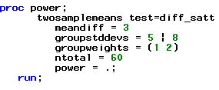
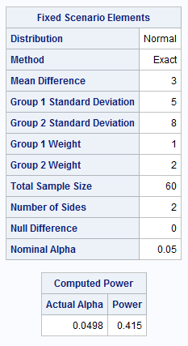
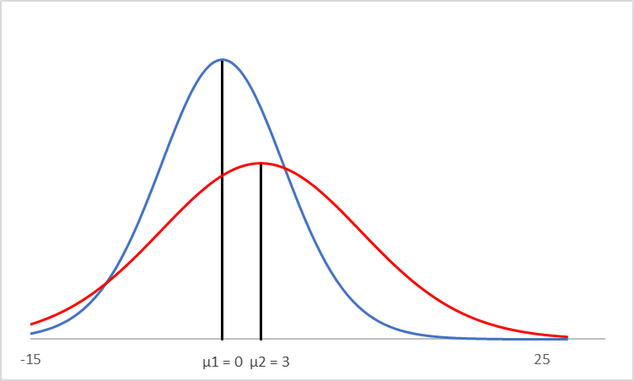
5. Use proc power to find the power of a test to detect a difference of 3 in the means if the two groups have standard deviations of 5 and 8, respectively, and sample sizes 20 and 40, respectively. Assume we want to use a Satterthwaite approximation (Welch’s test of difference of means assuming different standard deviations).

Slide 33
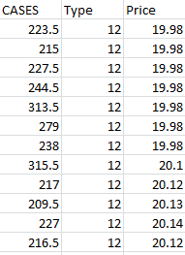
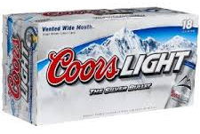
Beer Sales!!!
The data file contains 52 weeks of average-price and total-sales records for three different carton sizes: 12-packs, 18-packs, and 30-packs. (This is real data, apart from some very minor adjustments for the 30-packs.) We would like to perform an analysis to detect any differences in the mean or median sales between the 3 sizes of cases.
*The data are likely not independent. Sales from week to week are probably related and sales for each size are likely related by week. However, for our purposes, we will assume independence.

Slide 34

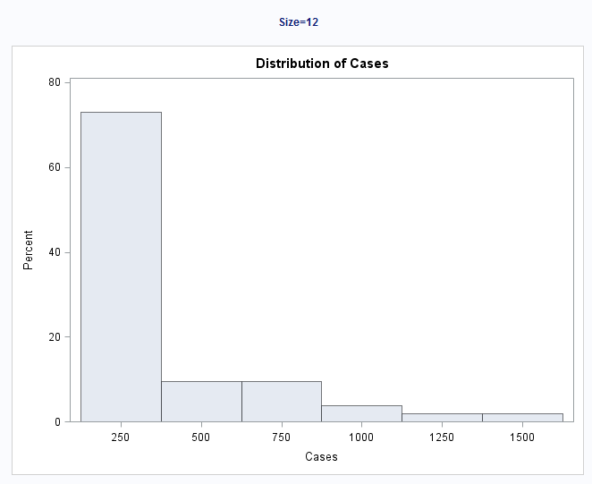
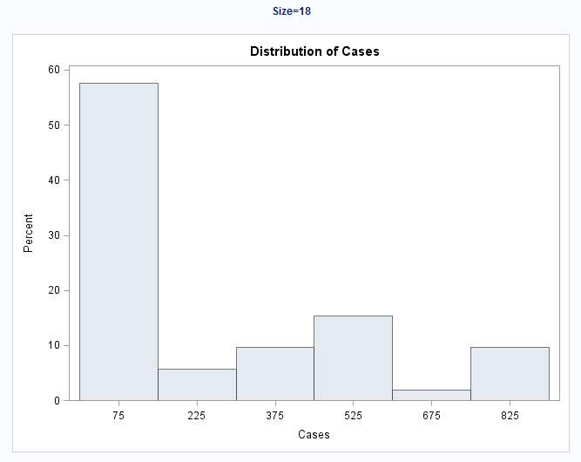
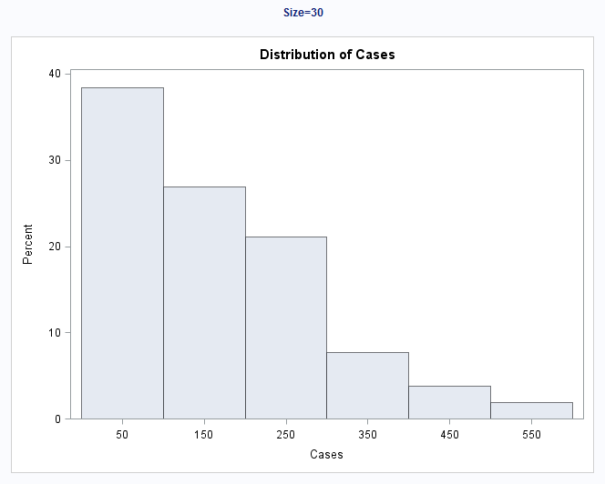
Beer Sales!!!
Clearly, there is strong visual evidence that the distribution of the amount of each size case sold is heavily right skewed. Looking closely at the units of the x-axes, we can see that there is strong visual evidence that the standard deviations are quite different.

Slide 35

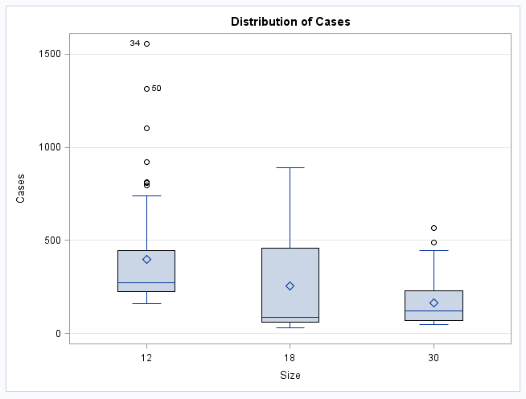
Beer Sales!!!!
Visual evidence of the right skew and heteroscedasticity is also shown in the box plot:
A transformation might be able to fix the normality and unequal standard deviations problems.

Slide 36
Analysis
As noted above, there is strong evidence against normality of number of cases sold from the three case sizes and strong evidence that the standard deviations are different as well. However, we will argue that the sample sizes are large enough per group to make Welch’s ANOVA and Student t-tests robust to the normality assumption (CLT), and we know that Welch’s ANOVA and Student t-tests are robust to the equal standard deviation assumption, especially when sample sizes are similar.* Therefore, we will use these tests to test for differences in means.
*Even though traditional t-tools are robust to some level of different standard deviations when the sample sizes are similar, traditional ANOVA (with more than two groups) is not nearly as robust to different standard deviations, even when the samples sizes are similar (although equal sample sizes help). Therefore, we will use Welch’s ANOVA and traditional t-tests.

Slide 37
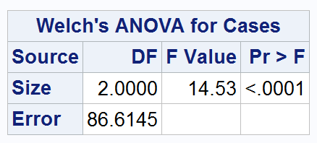

Test for any difference? Welch’s ANOVA
proc glm data = beer;
class type;
model Cases = type;
means type / welch;
run;
There is overwhelming evidence that at least 1 pair of case sizes have different mean sales (p-value < .0001). Note that this is NOT a complete analysis.

Slide 38

Test for the Differences: Bonferroni
There is overwhelming evidence that the 12 packs have greater mean sales than both 18 packs and 30 packs. A 95% confidence interval for the difference is (28.55, 256.44) cases for the 18 packs and (120.18, 348.07) cases for the 30 packs. Note that this is not a complete 6 step analysis.
proc glm data = beerlong;
class size;
model Cases = size;
means Size / bon cldiff;
run;

Slide 39







Alternative solution
We could be conservative with our assumptions and seek a non-parametric solution: Kruskal-Wallis. We will have to limit our tests to differences of distribution.
${ H}_{0}: F_{twelve }=F_{eighteen }=F_{thirty}$
${ H}_{A}:{ F}_{i }≠F_{j }$ for some i, j
$$2. Critical Value:can skip$$
$$3. Test Statistic:χ^{2}=30.5811$$
$$4. P−value< .0001$$
$$5.Reject H_{0}$$
6. There is strong evidence at the alpha = .05 level of significance (p-value < .0001 from the Kruskal-Wallis test) that at least one of the distributions is different from the other two. Three separate rank sum tests will be conducted with a Bonferroni multiple comparison adjustment in order to test for these differences. Could also do three separate signed-rank tests or sign tests and pair the data by week.

Slide 40




Beer Prices!!!
Since there are three simultaneous tests, we will adjust the alpha level down to .05/3 =0.0167. OR, we can adjust the p-values using a Bonferroni adjustment: .8225 * 3 > 1, .0005* 3=.0015, and .0001 * 3 = .0003. Therefore at the alpha = .05 family wise significance level, there is strong evidence that the distribution of 12 pack cases sold is different than the distribution of both 18 and 30 packs sold (Bonferroni adjusted p-values = .0015 and < .0003, respectively.) Note that this page is NOT a complete analysis.

